Slide 1
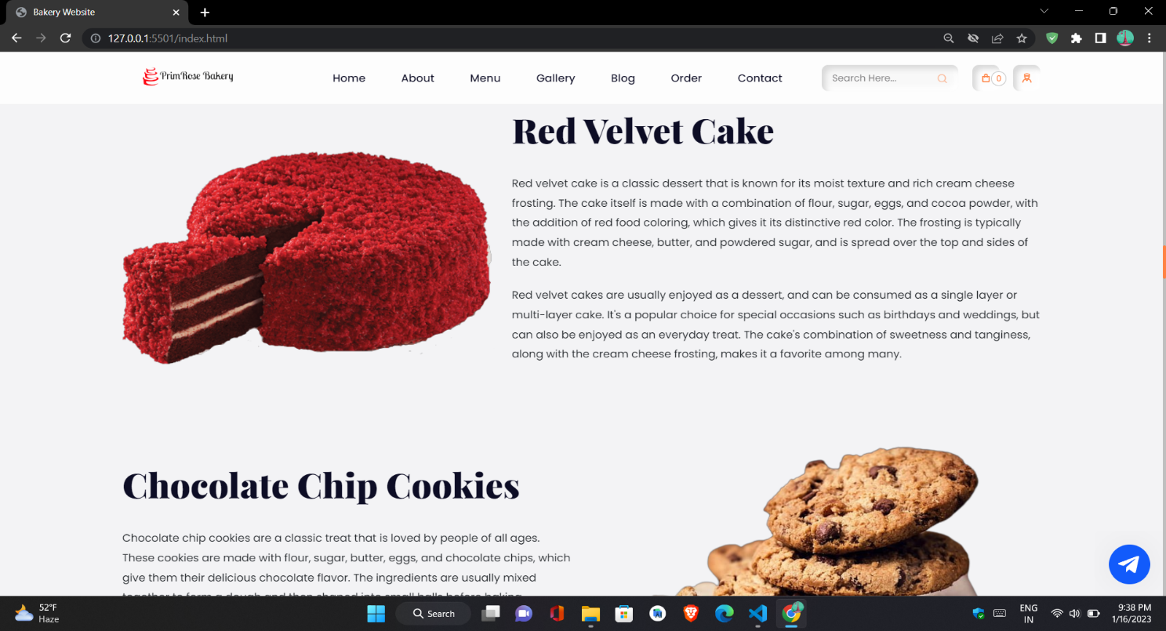
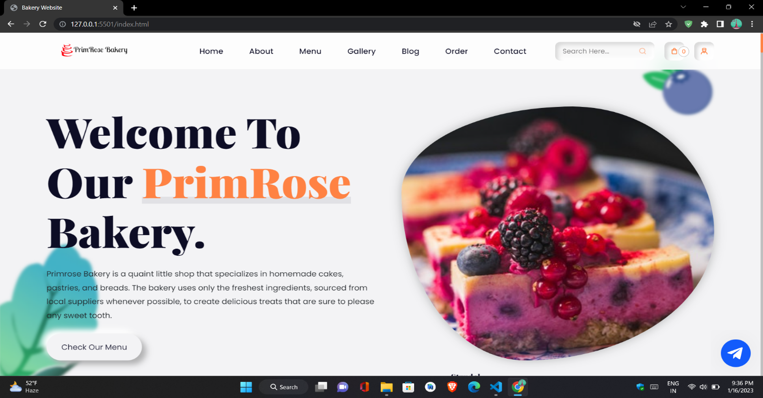
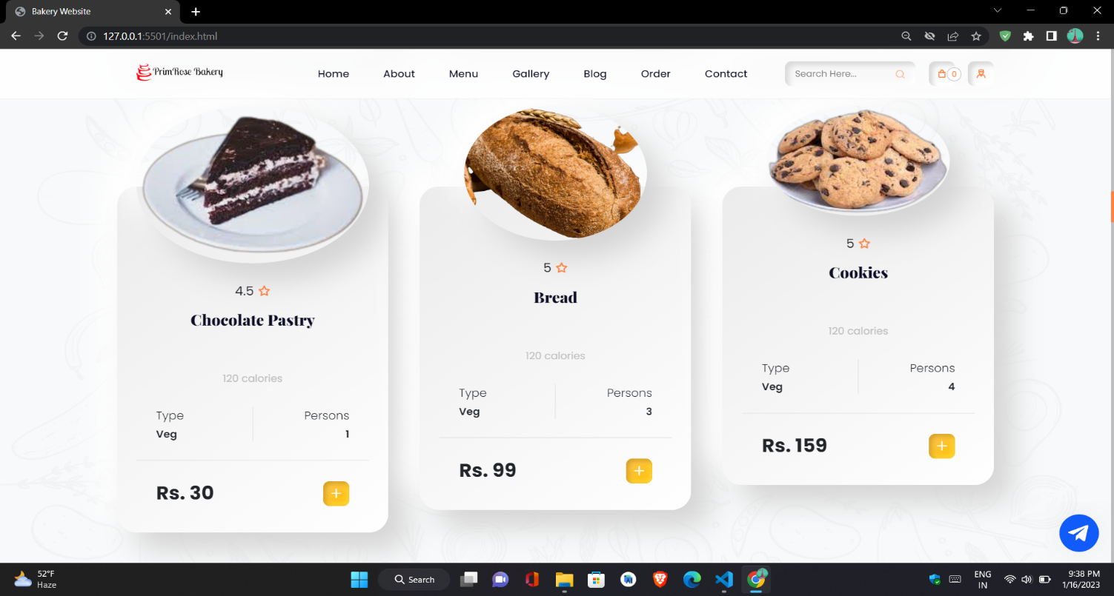
PROJECT ON BAKERY WEBSITE
Submitted By:
1. Shrey Agarwal
11715603120
2. Sudhanshu Purohit
12615603120

Slide 2
Table of Content
Introduction
Technologies Used
Methodologies used
Snapshots of the Project
Future Scope

Slide 3
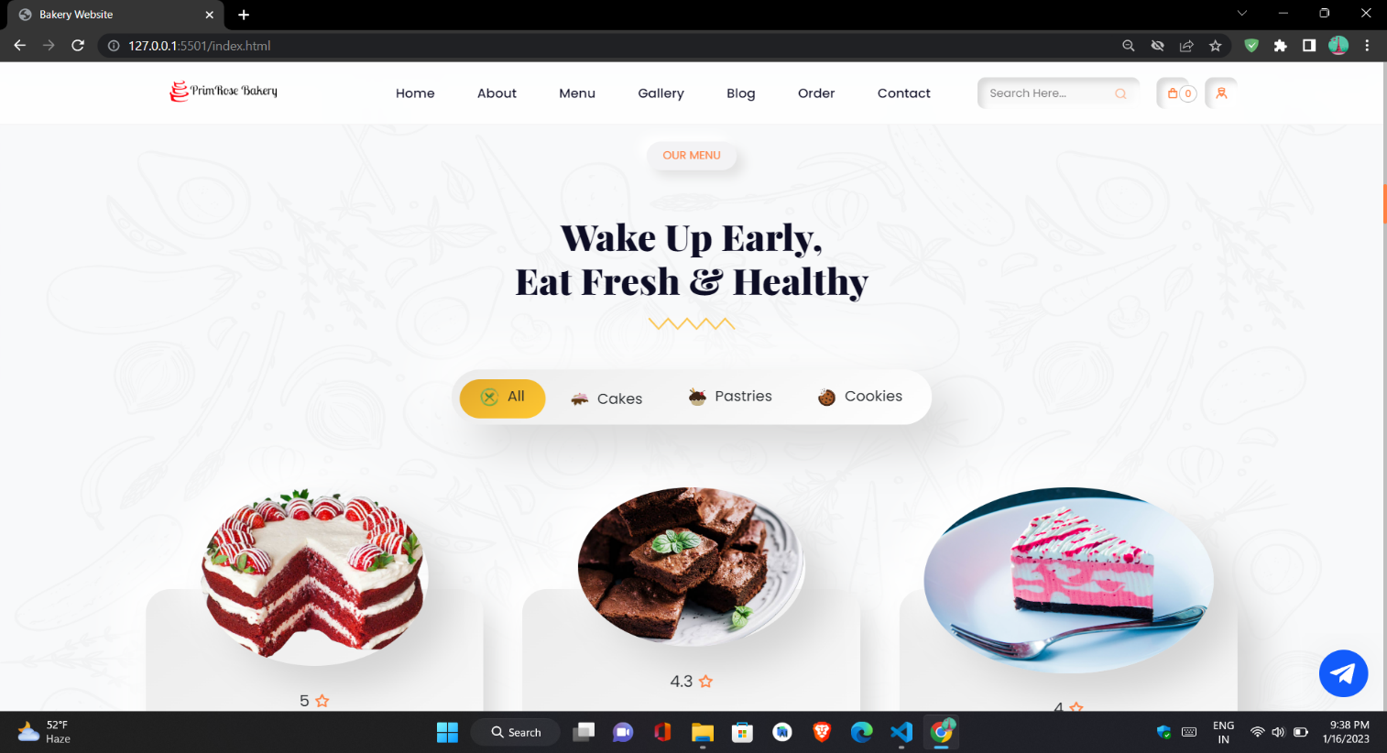
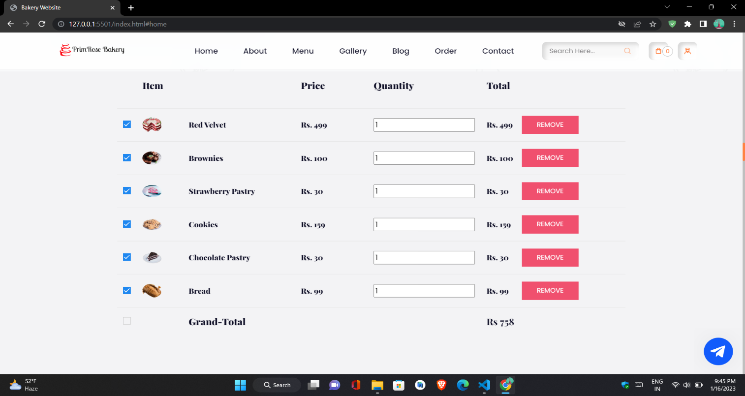
Introduction
Our Bakery Website Project aims to create a website for a bakery that allows customers to place orders online and view information about the bakery's products and services. The website will feature an easy-to-use interface for browsing and ordering items. The website will also include information about the bakery's history, mission, and values, as well as a gallery of images showcasing their products.

Slide 4




Technologies used
HTML (Hypertext Markup Language) is a markup language used to structure and organize content on the web. It is used to create the basic structure of web pages and to specify the layout, text, images, links, and other elements that make up the content of a website.
CSS (Cascading Style Sheets) is a style sheet language used to describe the presentation of a document written in HTML or XML. It is used to control the layout, colors, fonts, and other visual aspects of web pages.
JavaScript is a programming language that is primarily used to create interactive and dynamic web pages. It is a client-side scripting language, which means that the code is executed by the web browser on the user's device, rather than on a server.
Firebase is a mobile and web application development platform developed by Firebase, Inc. in 2011, then acquired by Google in 2014. It provides a set of tools and services for developing, maintaining, and growing web and mobile applications. It includes features such as real-time databases, authentication, and hosting, among others. Firebase is used by developers to build high-quality apps and grow their user base.

Slide 5
Methodologies used
Steps Involved in building the project
Created a Landing Page, with multiple options and clean user interface
Created multiple sections for different types of activities including menus, gallery etc.
User can add, remove products to/from the cart and can proceed with the order
Chatbot is also programmed which can help the user with the queries .
User data is stored using Firebase.
Responsive design is created so that website can be accessible in any device without any issues.

Slide 6
Snapshots of the website
Home Section

Slide 7
Menu Section

Slide 8
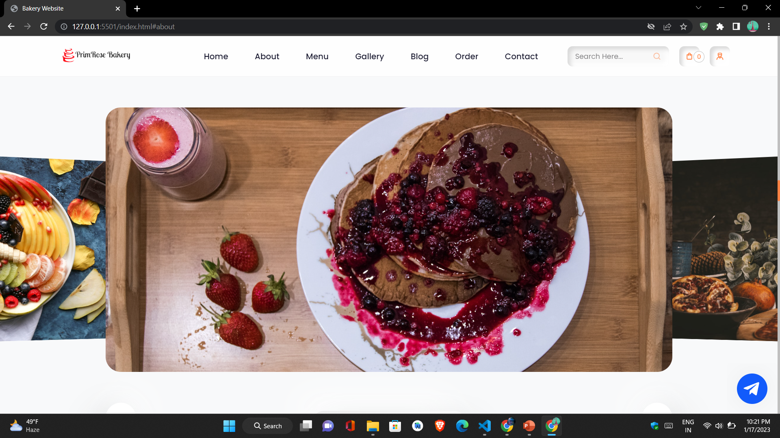
Gallery Section

Slide 9
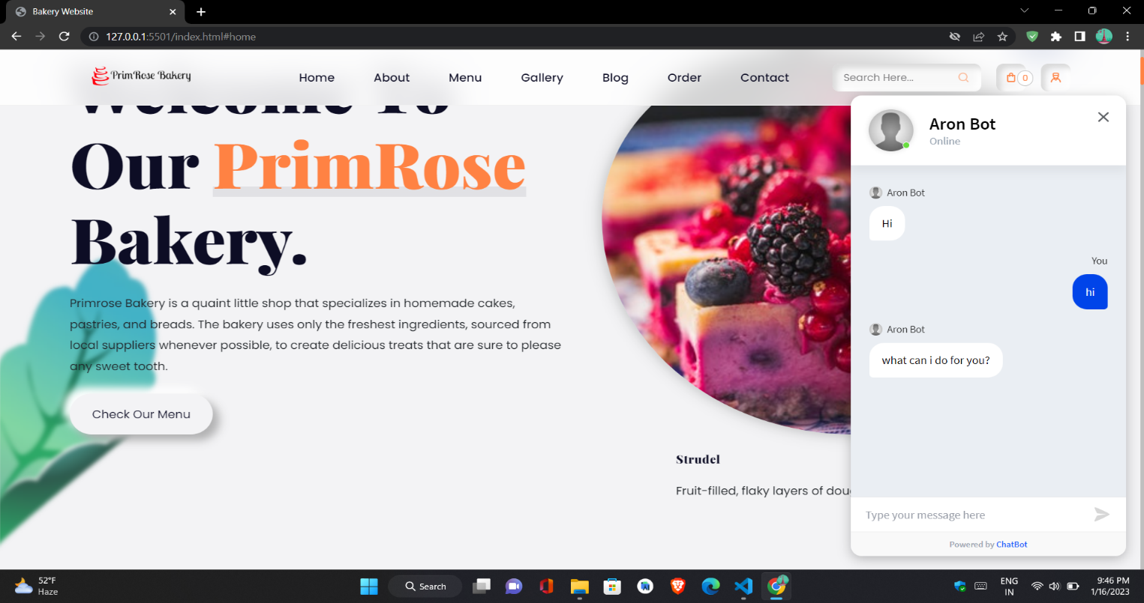
Chat Bot

Slide 10
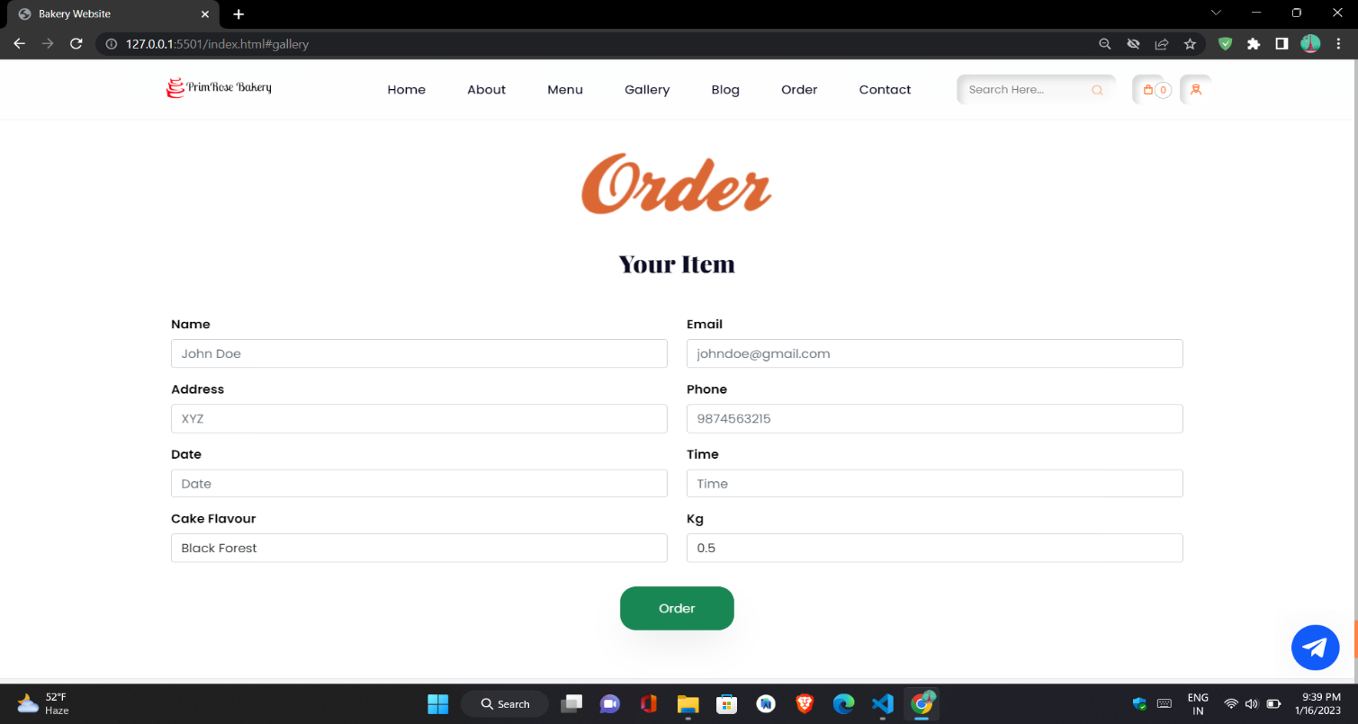
Order Section

Slide 11
Cart Section

Slide 12
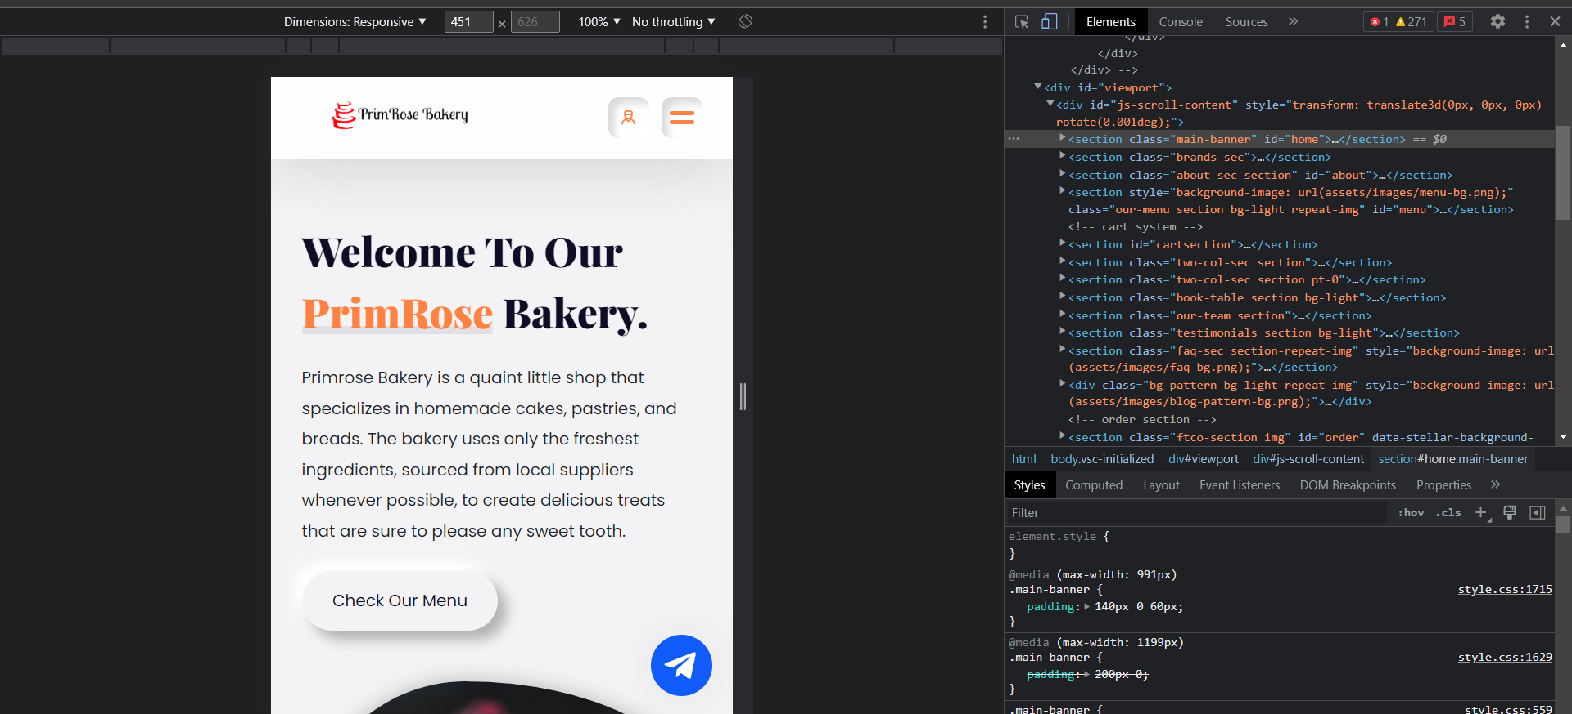
Responsive Design

Slide 13
Future Scope
The future scope of a bakery website can include several potential developments that could improve the user experience, increase sales and improve the overall performance of the business. Some of the potential future scopes for a bakery website include:
1. Online payments integration: Allowing customers to make payments online, for example, through credit card, PayPal or other electronic payment methods, would make the ordering process even more convenient for customers.
2. Mobile optimization: Developing a mobile-optimized version of the website, or creating a mobile app, would make it easier for customers to place orders and access the website on their mobile devices.
3. Online ordering and delivery system: Implementing an online ordering and delivery system would allow customers to place orders and have them delivered to their homes, increasing the convenience and accessibility of the bakery's products.
4. Virtual tours and product demonstrations: Adding virtual tours of the bakery's facility and product demonstrations to the website would give customers a better sense of the bakery's products and operations.
5. Social media integration: Integrating the website with social media platforms such as Facebook and Instagram, would allow customers to share their experiences and promote the bakery to their friends and followers.

Slide 14
THANK YOU

